Slide 1
Ice-Cream Businesses on Yelp
Group 2: Jingyun Jia, James Wan, Ziao Zhang

Slide 2
Data Cleaning
Original Data: n ≈ 5.36 million reviews, m ≈ 155 thousand businesses
Goal: Explore businesses that serve ice creams on Yelp and give some commercial advice based on our analysis about the Yelp datasets

Slide 3
Data Cleaning
Ice-Cream Data:
Filter businesses with keyword “Ice Cream” in the category field, and then filter their reviews:
n = 151,330 reviews from m = 2,657 businesses
2. Tokenize the text of each review into single words and count their frequency in each review.
3. Eliminate some stop words (default in R’s package):
p = 4,930,703 filtered words in total

Slide 4
Final Data (for the first-step data cleaning)
review | stars | useful | funny | cool | word | count
1 | 5 | 2 | 5 | 2 | actual | 1
1 | 5 | 2 | 5 | 2 | chunks | 1
1 | 5 | 2 | 5 | 2 | crust | 1
1 | 5 | 2 | 5 | 2 | custard | 1
1 | 5 | 2 | 5 | 2 | diamond | 2

Slide 5
Original Question
What flavors of ice cream could improve/lower the star ratings of ice-cream businesses on Yelp?

Slide 6
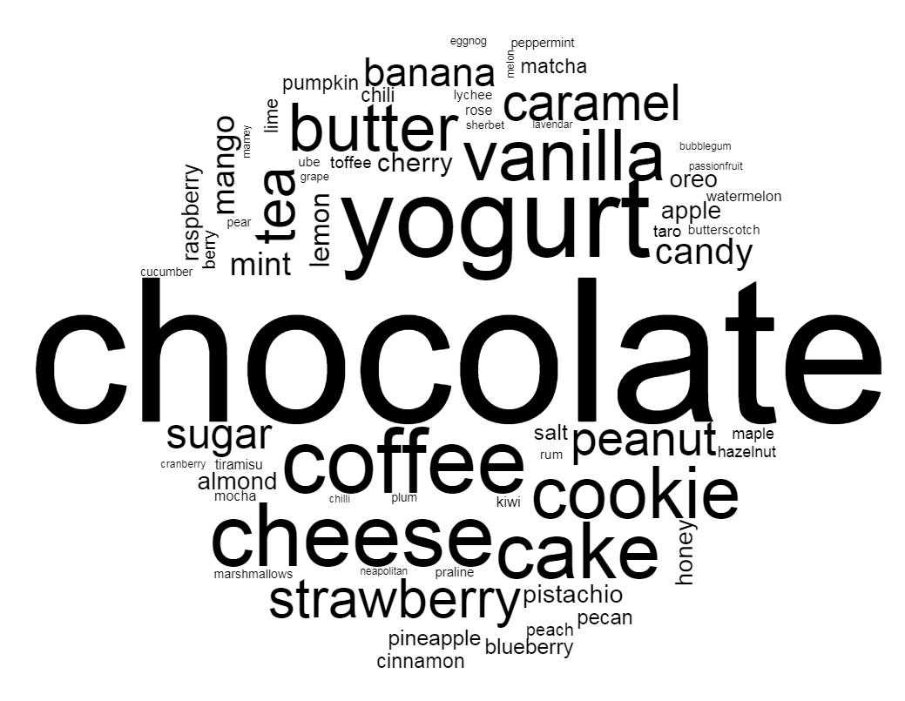
Flavor
Common flavors searched from Google and Wikipedia
67 flavors in total

Slide 7
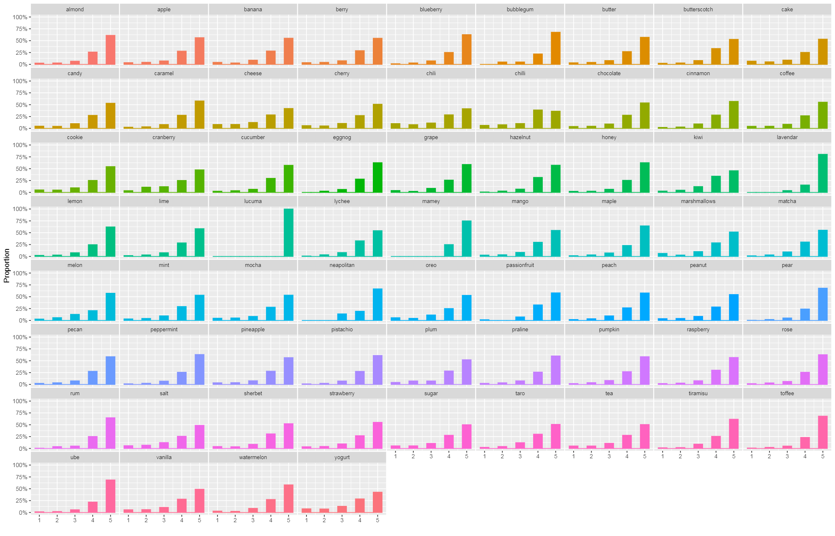

Slide 8
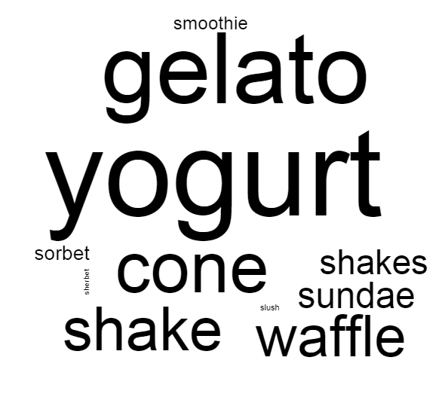
Type
Common ice-cream types searched from Google and Wikipedia
11 types in total

Slide 9
Final Data (for the ice-cream types)
“Ice-cream type” word frequency in each review:
reviewID | stars | useful | funny | cool | cone | yogurt | shake | …
5 | 4 | 5 | 2 | 4 | 2 | 0 | 0 | …
9 | 1 | 0 | 0 | 0 | 0 | 1 | 0 | …
Total “ice-cream type” word frequency in all reviews (sorted):
 | yogurt | gelato | cone | shake | waffle | sundae | …
Total | 16767 | 13371 | 9394 | 7804 | 7463 | 4310 | …

Slide 10
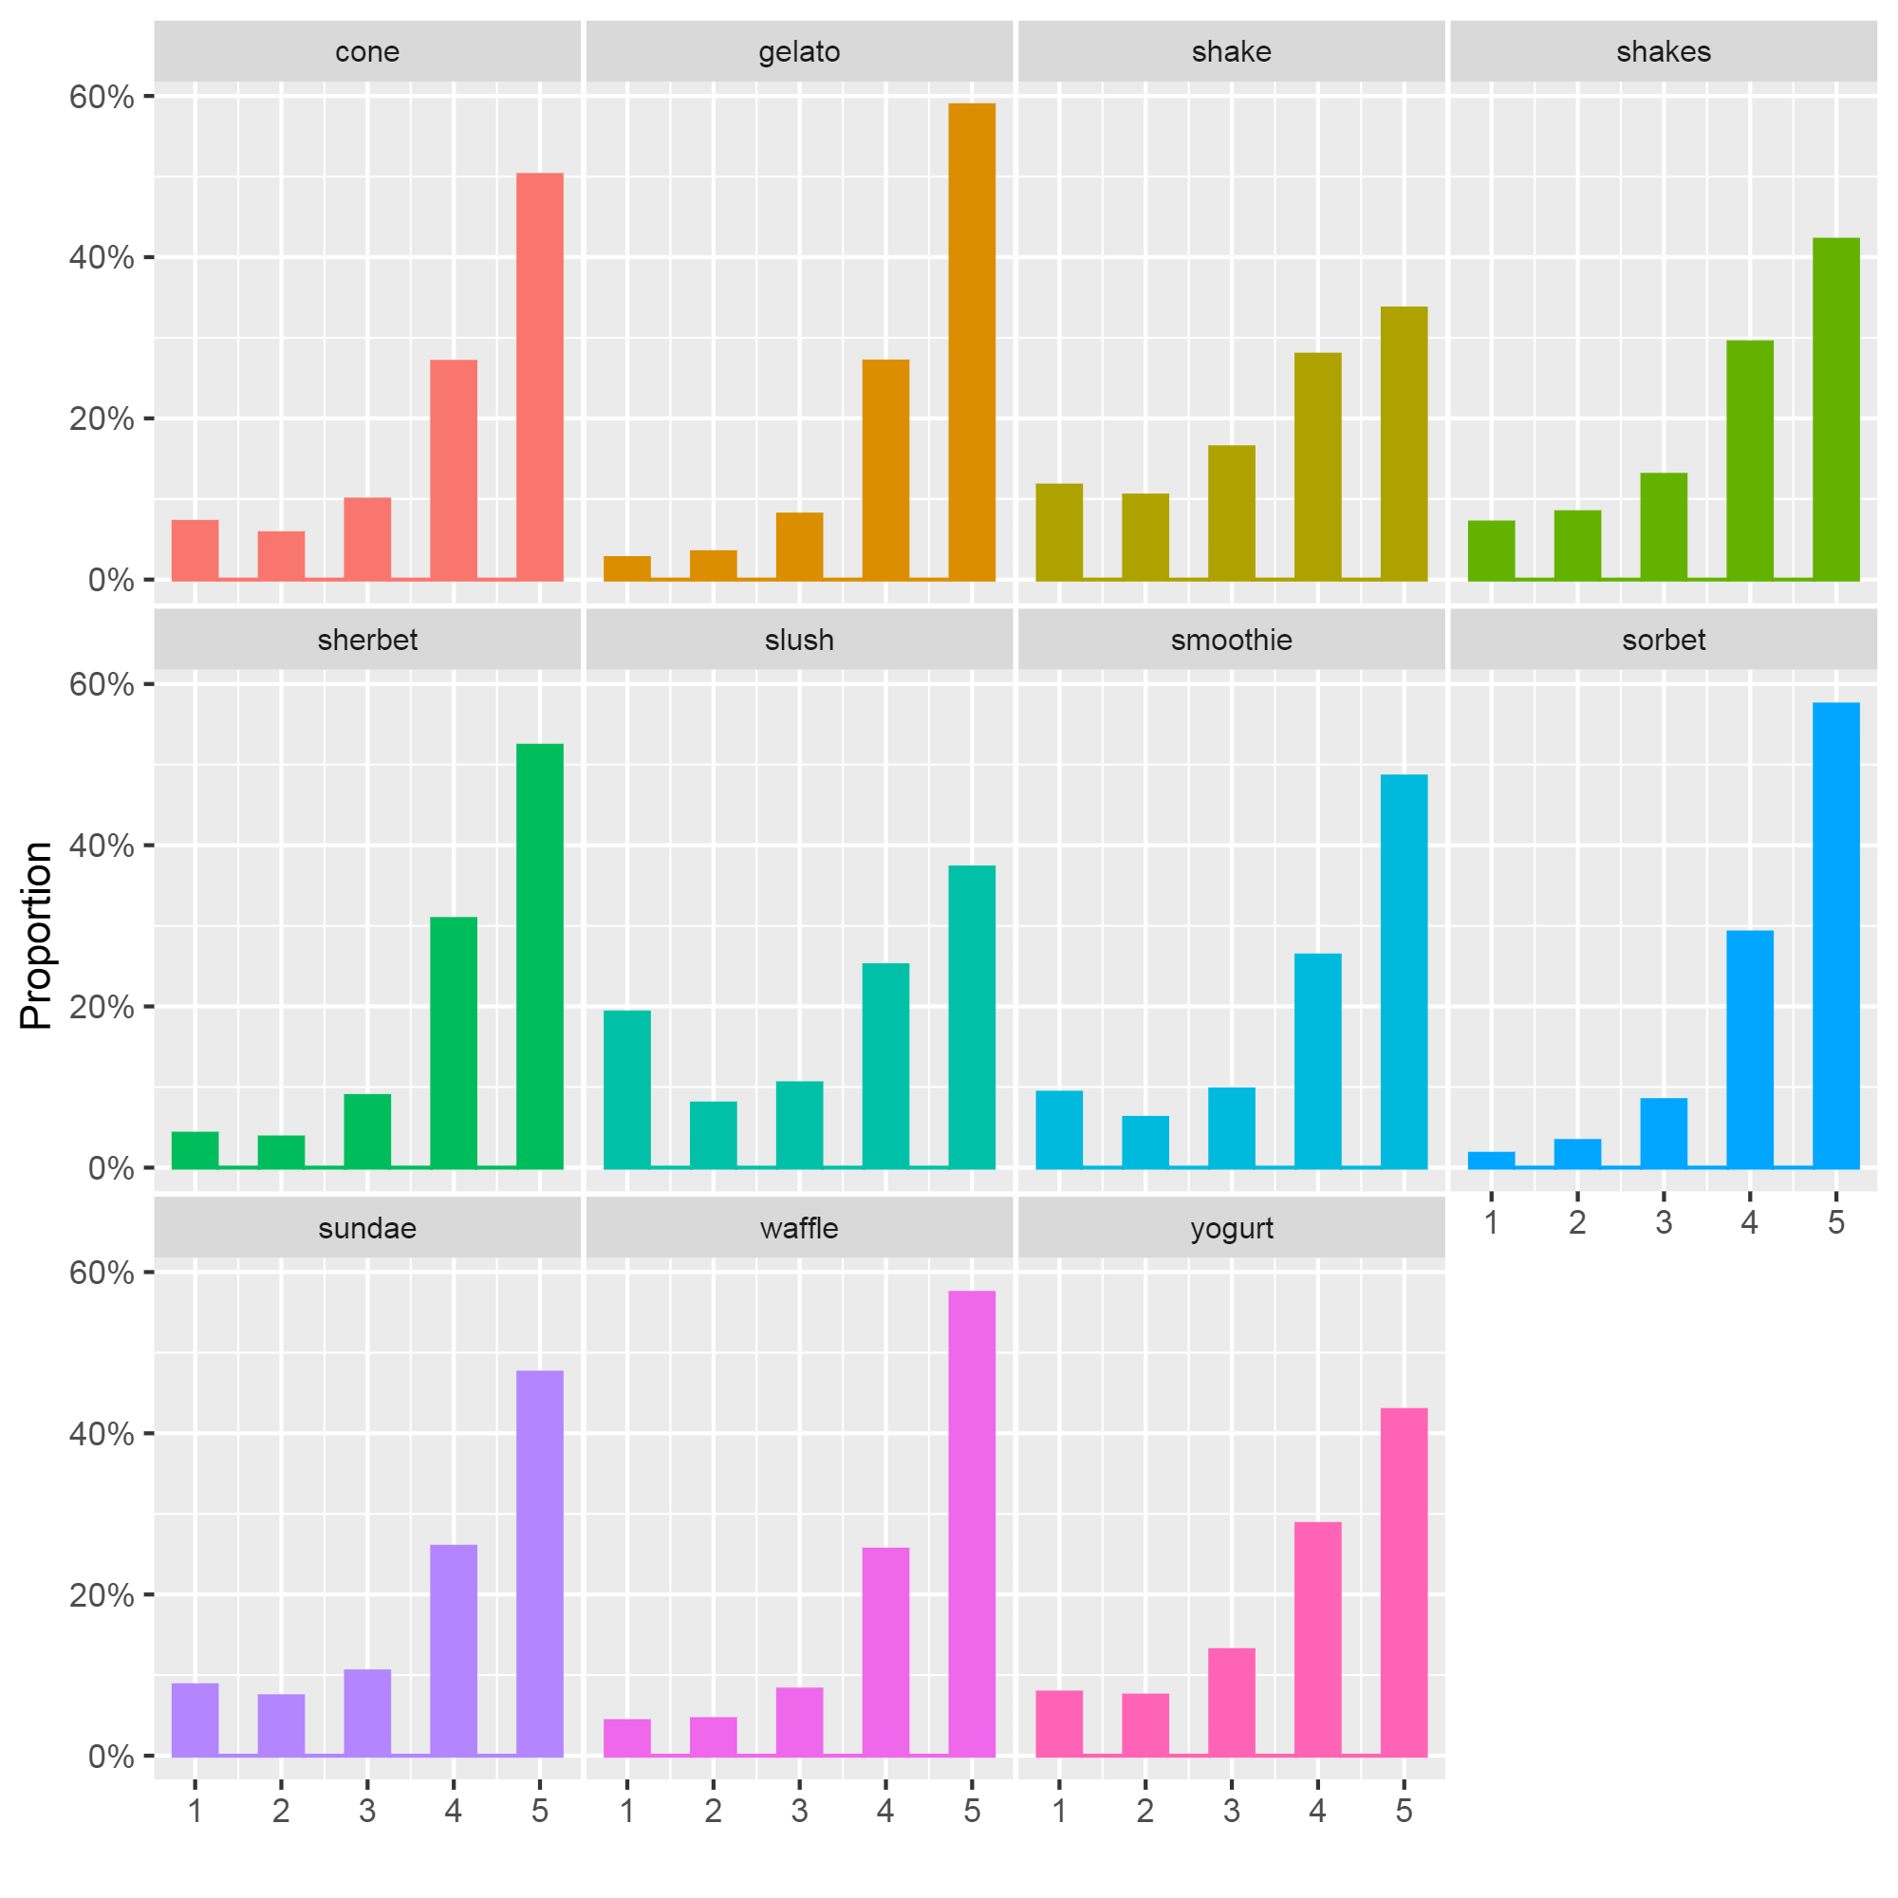

Slide 11
Refined Question
What types of ice cream could improve/lower the star ratings of ice-cream businesses on Yelp?
Does ice-cream type have significant influence on the star ratings of ice-cream business on Yelp?
(t- test, nonparametric test)

Slide 12
Thank you!

